Slide 1

Machine Learning for Sensorless Temperature Estimation of a BLDC Motor for ADAS
This presentation explores the application of machine learning techniques to accurately estimate the temperature of a brushless DC (BLDC) motor without the use of traditional temperature sensors. This innovative approach can enhance motor performance, improve reliability, and potentially extend the motor's lifespan.

Slide 2
Table of contents
01
02
03
04
05
06
Overview
Objective
Abstract
Problem Statement
Methodology
Impact and Benefits

Slide 3



Overview of BLDC Motor Operation
Working Principle
Types
Applications
BLDC motors operate based on the interaction between a magnetic field generated by permanent magnets in the rotor and an electromagnetic field created by current flowing through the stator windings.
There are various types of BLDC motors, including inrunner and outrunner configurations, each with different performance characteristics. Choosing the right type depends on the application.
BLDC motors are widely used in various applications like electric vehicles, drones, robotics, and industrial automation, due to their high efficiency and precise control.

Slide 4

Objective
The primary objective is to apply machine learning techniques to estimate the temperature of a Brushless DC (BLDC) motor without using traditional physical temperature sensors. This approach aims to enhance motor performance, improve reliability, and potentially extend the motor's lifespan by predicting the temperature and power loss based on data such as input temperature, time, current and voltage.

Slide 5
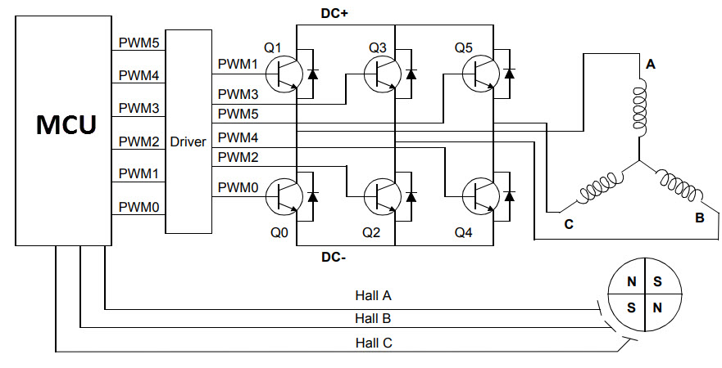
Abstract
This project explores the use of machine learning to estimate the temperature of a BLDC motor without using traditional temperature sensors. By utilizing sensor data such as current, voltage, and speed, a machine learning model can predict motor temperature in real-time. The project involves data acquisition, preprocessing, feature engineering, model training, and evaluation. The proposed solution aims to reduce costs, improve motor reliability, and extend its lifespan by preventing overheating. This sensorless approach can significantly enhance motor control in various applications, including electric vehicles, robotics, and industrial automation​.

Slide 6


Problem Statement – Traditional methods of temperature
estimation rely on physical sensors, which can increase
costs and will be prone to wear and tear
Data Acquisition
Collecting extensive data from various operating conditions of the motor, including load, speed, and ambient temperature, is essential for training the machine learning model which hence helps improve motor control and avoid potential overheating.
Sensorless Temperature Estimation
Real-time Prediction
This approach leverages machine learning algorithms to predict motor temperature based on readily available sensor data, such as current, voltage, and speed.
The trained model can be deployed on an embedded system or controller to provide real-time temperature predictions based on sensor data, eliminating the need for physical temperature sensors.

Slide 7


Methodology
Multiple Linear Regression
Support Vector Regressor
Random Forest Regressor
XGBoost Regressor

Slide 8
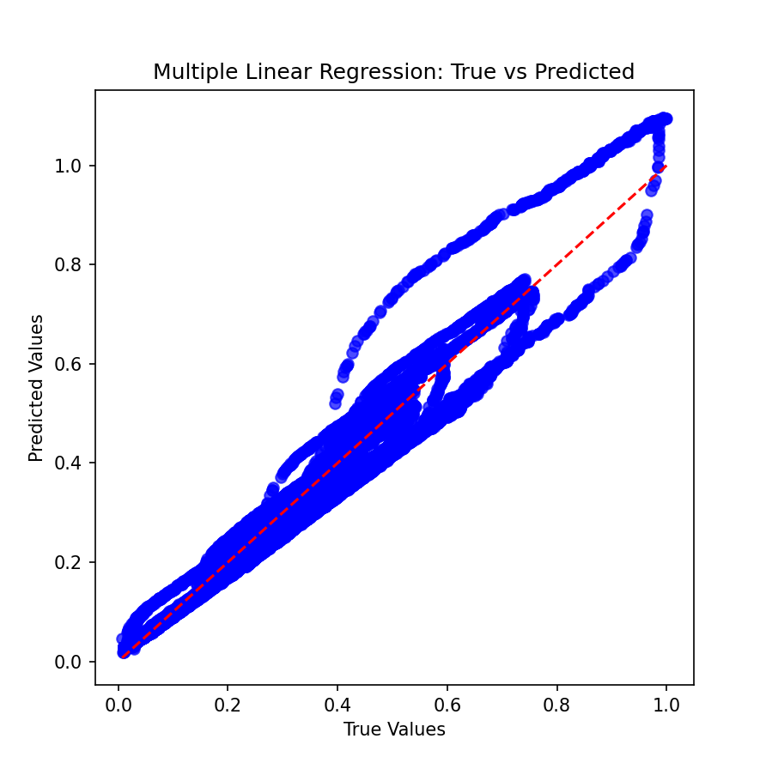
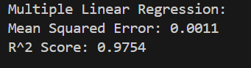
Multiple Linear Regression
→ Multiple linear regression is a statistical technique that models the relationship between two or more independent variables and a dependent variable by fitting a linear equation to observed data.
→ The algorithm finds the best-fitting line by minimizing the sum of the squares of the differences (residuals) between observed and predicted values. This is typically done using the Ordinary Least Squares (OLS) method.

Slide 9
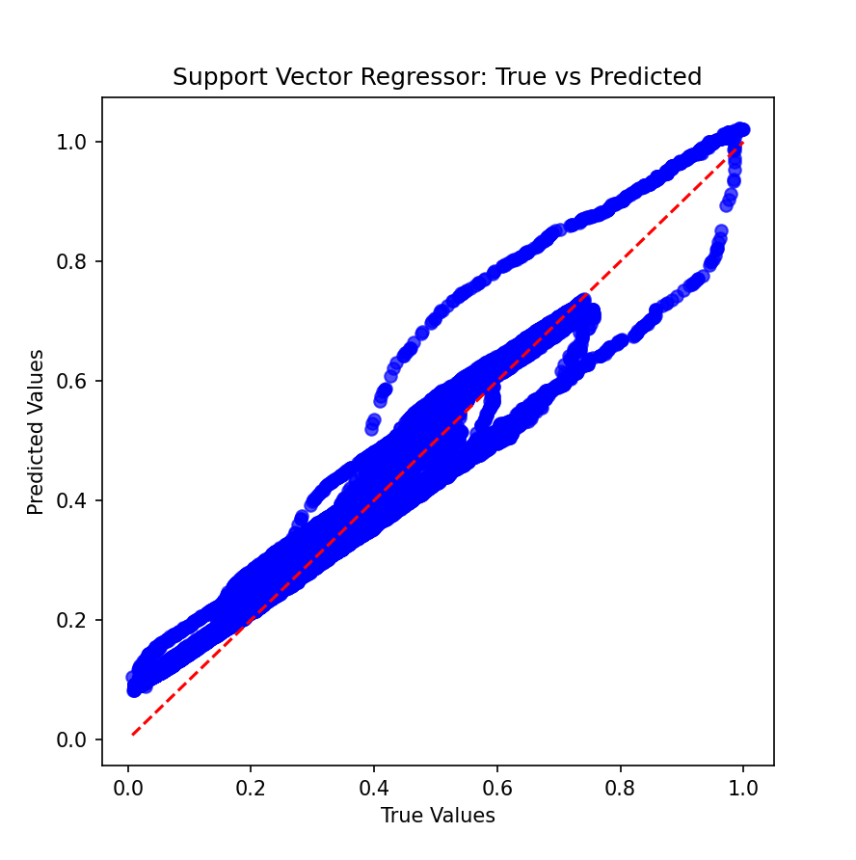
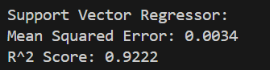
Support Vector Regressor
→ Support Vector Regression is an extension of Support Vector Machines (SVM) that is used for regression tasks. It aims to find a function that deviates from the actual observed values by a value no greater than a specified margin (epsilon).
→ SVR tries to find the best hyperplane that fits the data with a margin of tolerance (epsilon). It also introduces a penalty for points that fall outside this margin, controlled by the regularization parameter

Slide 10
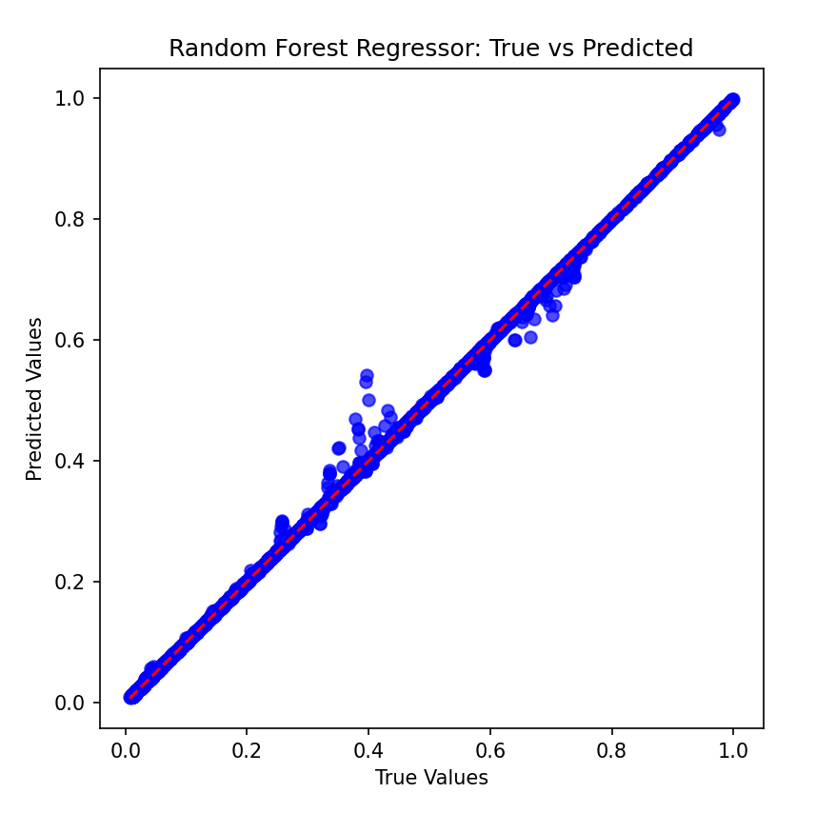
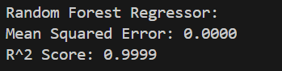
Random Forrest
→ Random Forest is an ensemble learning method that operates by constructing multiple decision trees during training and outputting the average prediction of the individual trees for regression tasks.
→ Each tree is trained on a random subset of the data, and at each split in the tree, a random subset of features is considered for splitting.
→ The prediction is made by averaging the predictions of all the trees in the forest. This reduces overfitting and improves accuracy compared to a single decision tree.

Slide 11
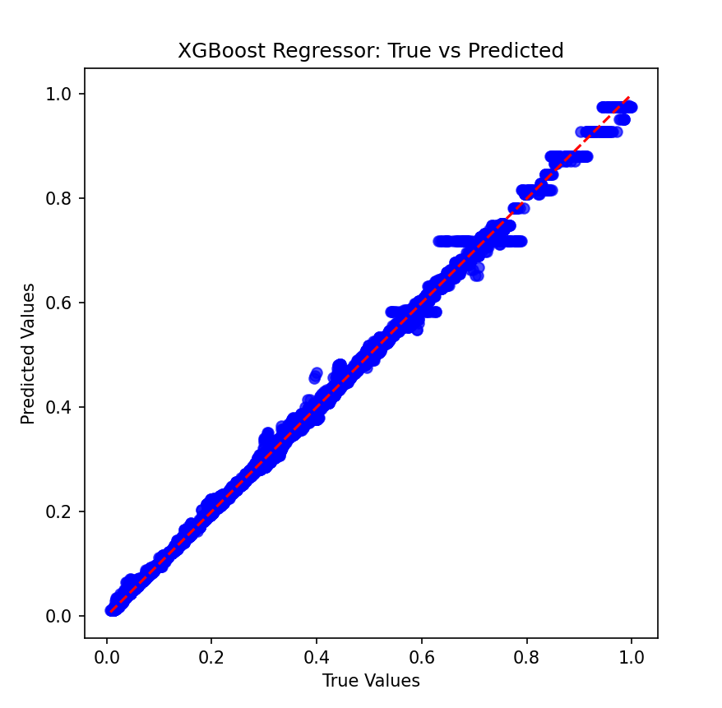
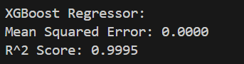
XGBoost Regressor
→ XGBoost (Extreme Gradient Boosting) is an efficient implementation of gradient boosting, which is a technique for building models in an ensemble fashion. It combines the predictions of multiple weak learners (usually decision trees) to create a strong model.
→ XGBoost builds trees sequentially, with each tree trying to correct the errors made by the previous ones. The loss function is minimized using gradient descent, and regularization helps to prevent overfitting.
→ It includes features like handling missing values, parallel processing, and tree pruning, making it highly efficient and powerful for various machine learning tasks.

Slide 12
Comparative Analysis
Model | Mean Squared Error (MSE) | R² Score | Advantages | Disadvantages
Multiple Linear Regression | Higher than others | Lower | Simple, interpretable, quick to compute | Assumes linearity, sensitive to outliers
Support Vector Regression (SVR) | Moderate | Moderate | Works well in high-dimensional spaces, robust to outliers | Computationally intensive, requires careful tuning
Random Forest Regressor | Lowest | Highest | Robust to overfitting, handles non-linearity, feature importance | Less interpretable, more resource-intensive
XGBoost Regressor | Lower | Higher | Highly efficient, flexible with hyperparameters | Requires careful tuning, can overfit without proper settings

Slide 13
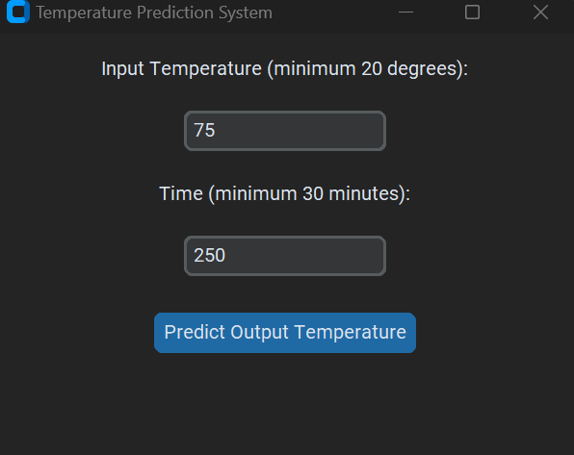
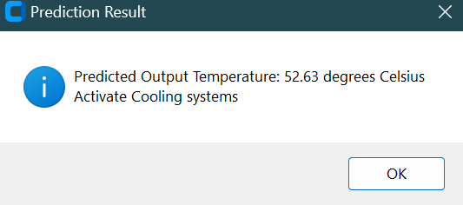
GUI Implementation
→ For our GUI, we have given the median value for the temperature O/P as 29.25, so if the predicted temperature goes above this value, then the cooling system will get activated.
→ ADAS sensors are also often used in non-ideal environments for electronics. In addition to the obvious vibration and shock requirements, sensors may be mounted in locations near a combustion engine where heat can build up. For many sensor locations, active cooling will not be viable and in hot climates the temperatures of sensors could increase significantly whilst the vehicle is stationary.

Slide 14

Impact and Benefits
Enhanced Performance
Real-time temperature monitoring allows for optimal control of the motor, preventing overheating and maximizing efficiency.
Improved Reliability
Predicting temperature proactively reduces the risk of motor failure, leading to increased uptime and reduced maintenance costs.
Extended Lifespan
By preventing overheating and potential damage, the proposed solution can significantly extend the operating lifespan of BLDC motors.
Cost Reduction
Eliminating the need for physical temperature sensors can save costs associated with sensor installation, maintenance, and replacement.

Slide 15





Thank You

